Slide 1

Care for Poor
A small but strong initiative

Slide 2
About the project
01
Objective
02
TABLE OF CONTENTS
Project description
03
Result
04
Conclusion
05
A short overview of our project
The purpose of creating this project
How we created the project?
Screenshots of each page present in our website
What we conclude?

Slide 3
Future scope
06
References
07
TABLE OF CONTENTS
08
Team members
What new we can add in our project in future.?
Which sites we took help from.?
List of members and their UID’s

Slide 4

About the project
Our group decided to make a website for NGO which can help poor people in this COVID period . We know many people have lost there jobs in this lockdown so we decided to make a project which is helpful to society .We make a website where we can provide a platform to people who want to volunteer themselves to help needy people and spread awareness about some of the basic topics like vaccination, women health ,food etc.

Slide 5

OBJECTIVE
We saw many individuals stepping forward to help but they didn't exactly know how to contribute for this cause. This evoked a feeling of concern in us and hence we decided to provide them a platform to tackle the situation.

Slide 6
UI interface
Database creation
PROJECT DESCRIPTION
Database connection
Debugging
JavaScript
Structuring and designing all the html pages and the forms .
Making a database and required tables according to need of project on xammp server.
Improved the functionality of the web page using JavaScript
With the help of php we connected the html page and sql tables
Finding and correcting errors in the project

Slide 7
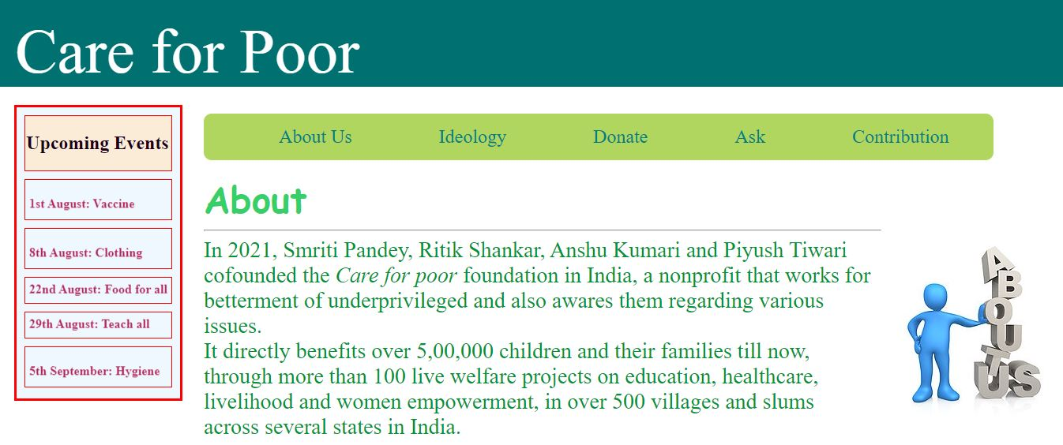
HOME PAGE

Slide 8
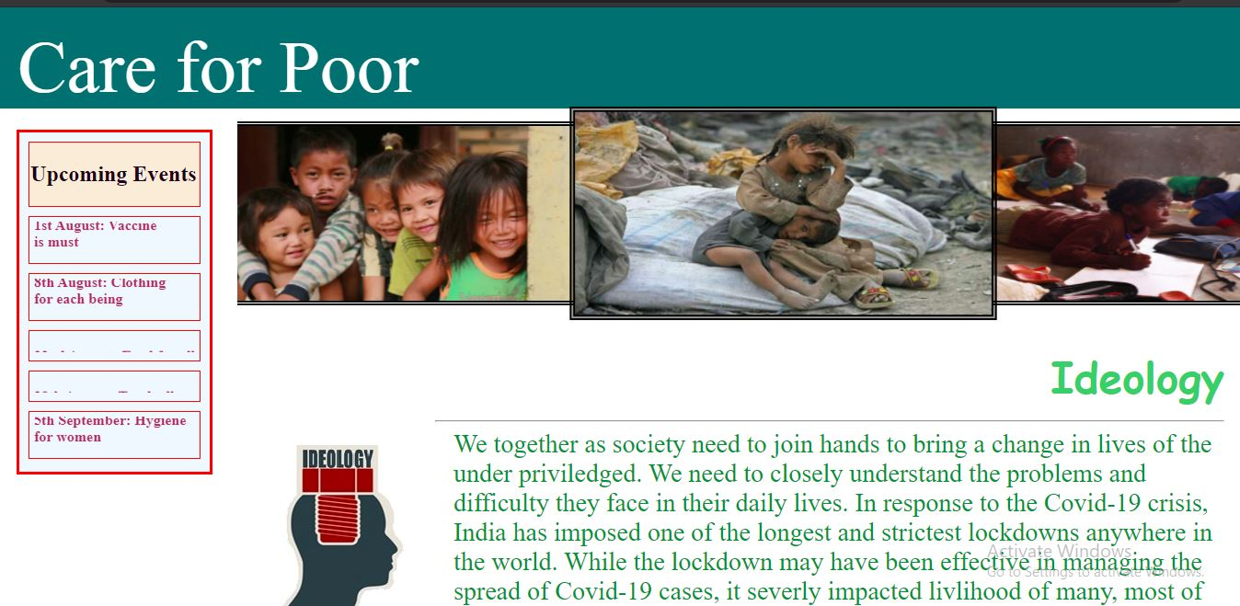
HOME PAGE

Slide 9
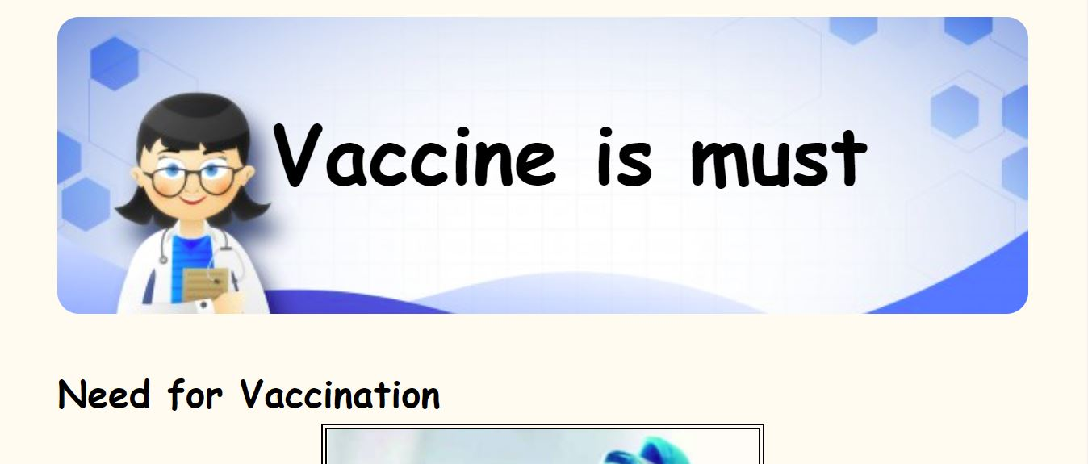
EVENTS PAGE

Slide 10
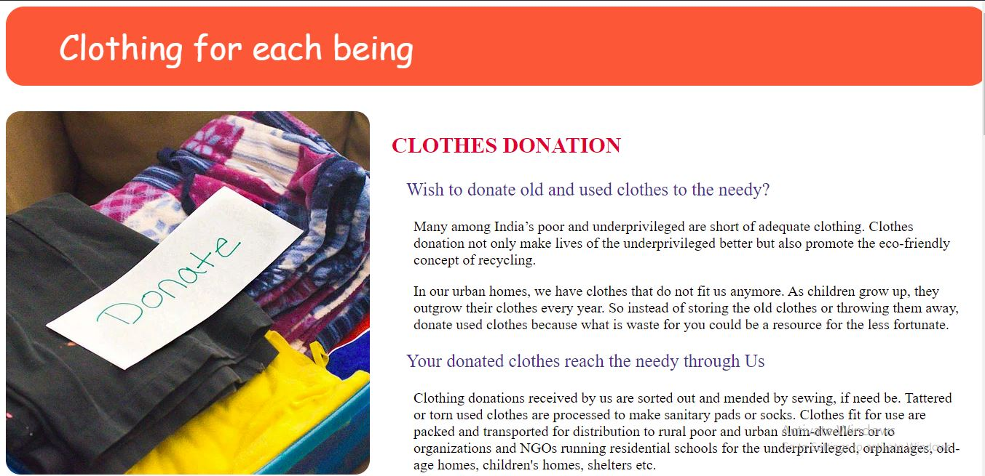
EVENTS PAGE

Slide 11
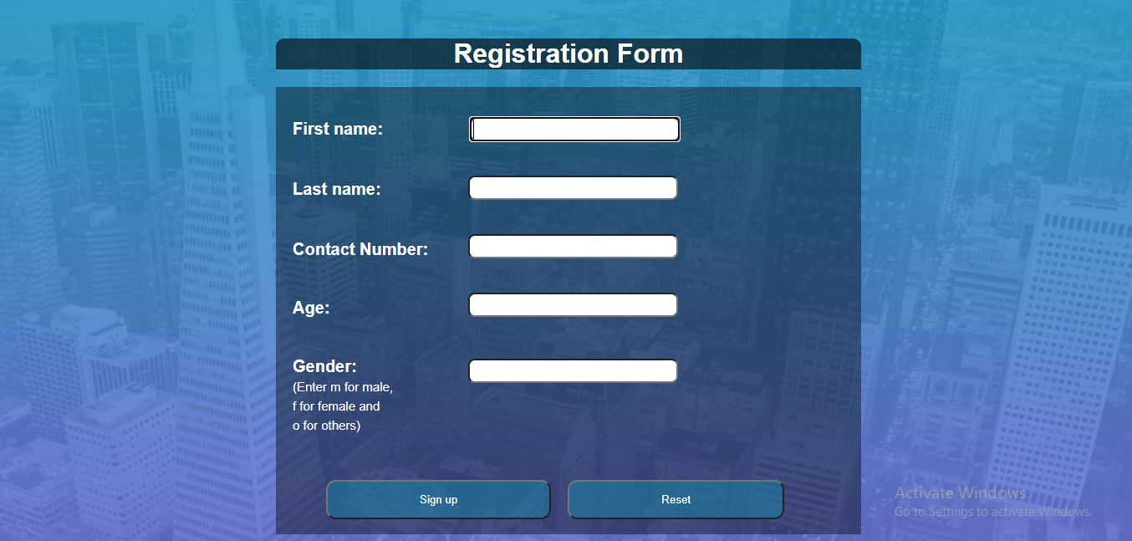
FORMS

Slide 12
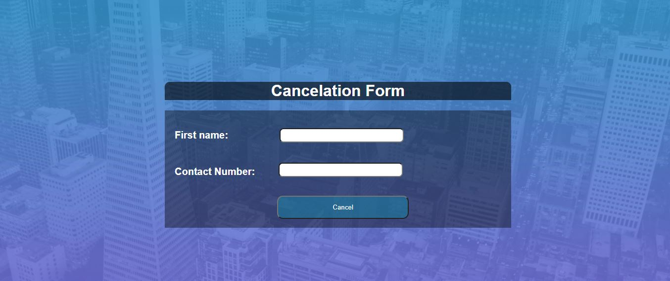
FORMS

Slide 13
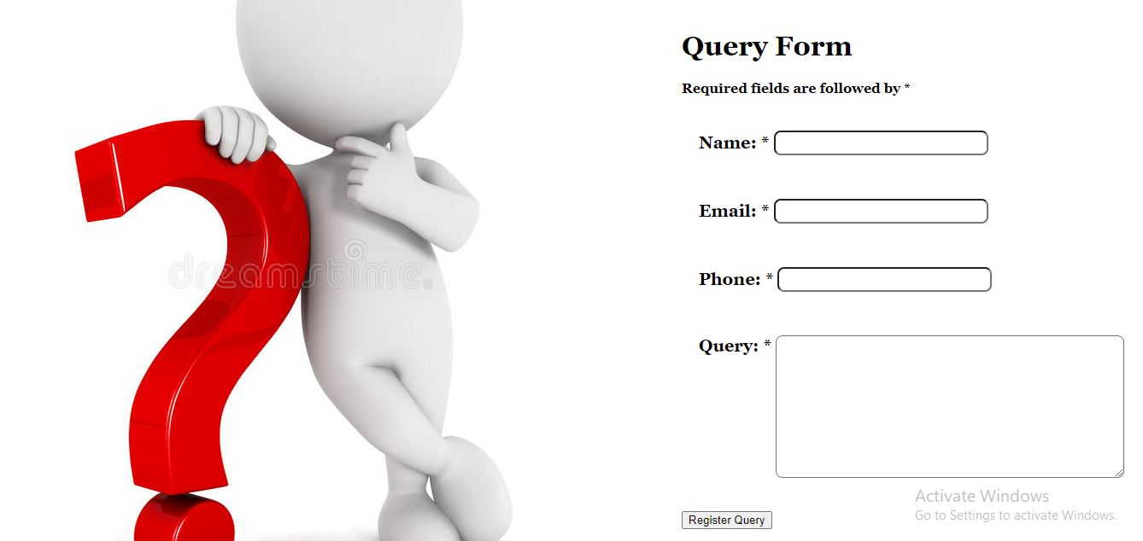
FORMS

Slide 14
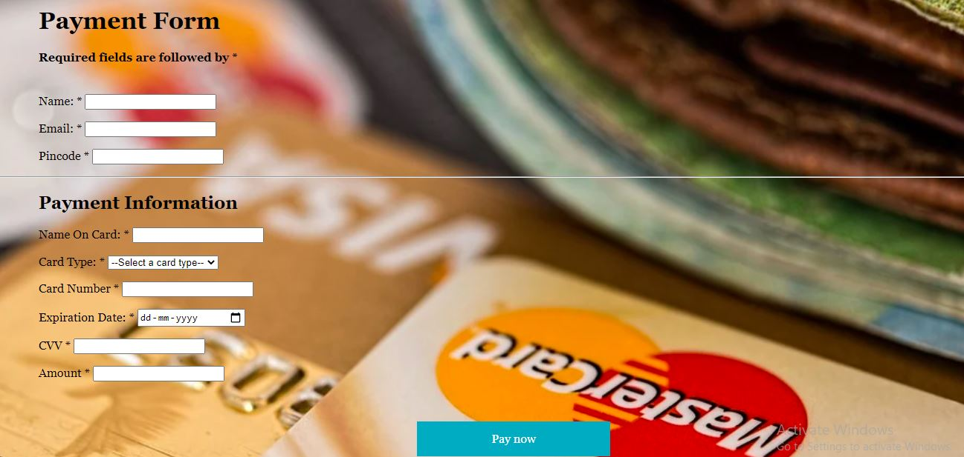
FORMS

Slide 15
Conclusion
In the end, we want to conclude that practical training is of great importance as it gives the exposure and an opportunity of presenting a seminar before the audience and with the help of our NGO we are able to revert back to our society. We can provide help to needy people with this organization.

Slide 16
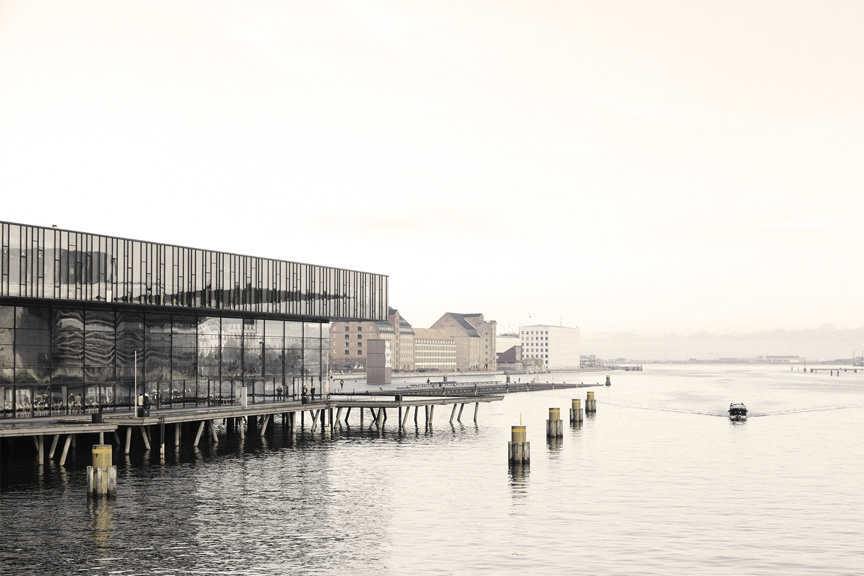

SCOPE 1
Future scope of the project
SCOPE 2
We can add a real payment gateway for actual transaction purpose.
We can send emails/SMS informing them about their successful registration for event or cancellation or submission or their query.

Slide 17
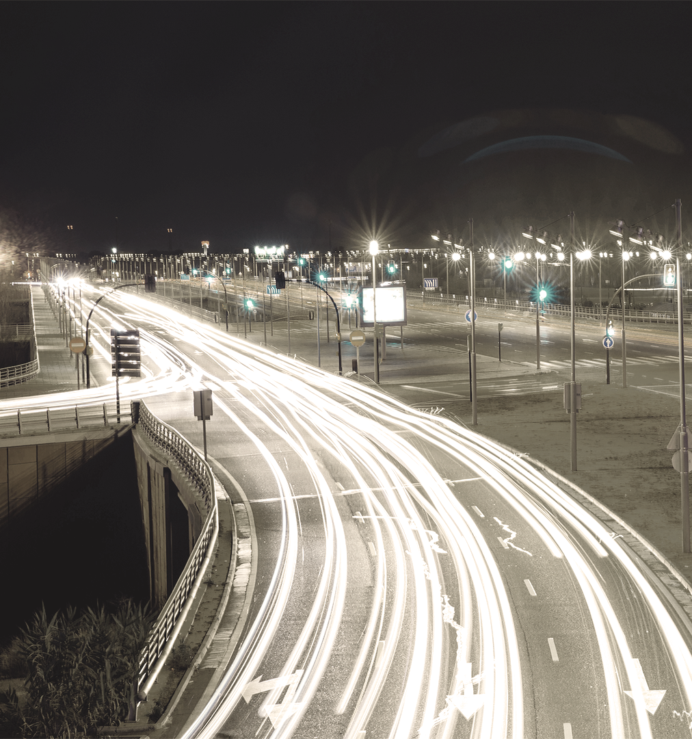
References
www.w3schools.com
Youtube chanel – Apna college
Youtube chanel - wpshopmart

Slide 18
SMRITI PANDEY
PIYUSH TIWARI
TEAM MEMBERS
RITIK SHANKAR
ANSHU KUMARI
20BCS1649
20BCS1672
20BCS1684
20BCS1683

Slide 19


